Slide 2
Some of the C# clauses for working with LINQ

Slide 3
Features of LINQ

Slide 4
The three stages of a query operation

Slide 5
A LINQ query that retrieves data from an array

Slide 6
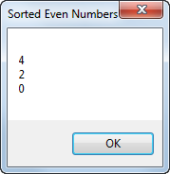
The resulting dialog box

Slide 7
The syntax of the from clause

Slide 8
An example that uses a generic list of invoices as the data source

Slide 9
An example that uses a generic list of invoices as the data source (cont.)

Slide 10
The syntax of the where clause

Slide 11
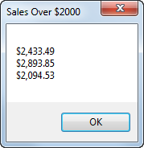
The resulting dialog box

Slide 12
An example that filters the generic list of invoices

Slide 13
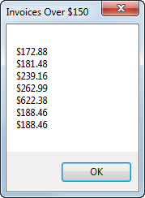
The resulting dialog box

Slide 14
The syntax of the orderby clause

Slide 15
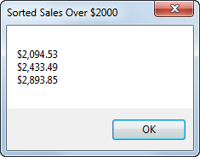
The resulting dialog box

Slide 16
An example that sorts the generic list of invoices

Slide 17
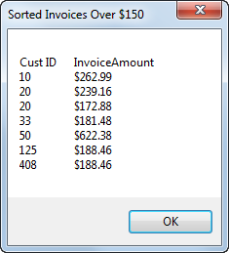
The resulting dialog box

Slide 18
Two ways to code the select clause

Slide 19
An example that selects key values from a sorted list

Slide 20
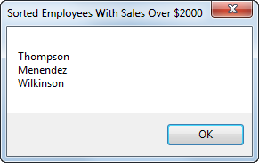
The resulting dialog box

Slide 21
A query expression that creates an anonymous type from the list of invoices

Slide 22
The basic syntax of the join clause

Slide 23
A query expression that joins data from the two data sources

Slide 24
Code that executes the query

Slide 25
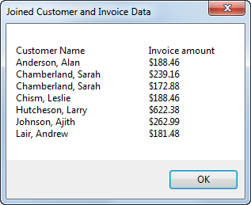
The resulting dialog box

Slide 26
An extension method that extends the String data type

Slide 27
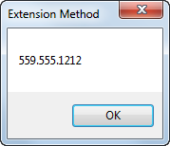
The resulting dialog box

Slide 28
Extension methods used to implement common C# clauses for LINQ

Slide 29
The basic syntax of a lambda expression

Slide 30
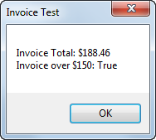
The resulting dialog box

Slide 31
A query that uses extension methods and lambda expressions

Slide 32
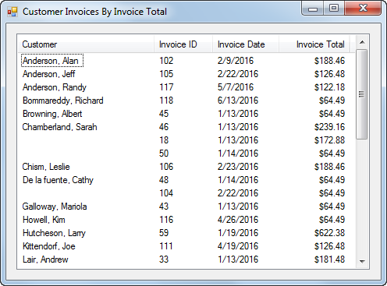
The Customer Invoice form

Slide 33
Customer Invoice form with generic lists

Slide 34
Customer Invoice form with generic lists (cont.)

Slide 35
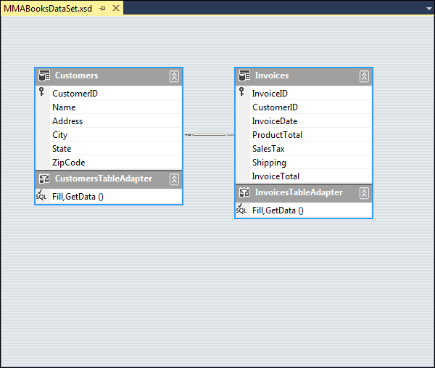
The dataset schema

Slide 36
Customer Invoice form with typed dataset

Slide 37
Customer Invoice form with typed dataset (cont.)

Slide 38
Extra 23-1 Use LINQ to create an Invoice Line Items application

Slide 39
Project 5-2 Display incidents by technician

